Slide 1


NRI INSTITUTE OF INFORMATION
SCIENCE & TECHENOLOGY
Submitted by
KESHAV [0115CA231053]
KHUSHI SAHU [0115CA231057]
SURAJ BISWAS [0115CA231128]
Semester – Fourth (4th)
Under the Guidance of
Prof. DEV NAGAR
DEPARTMENT OF MASTER OF Computer APPLICATION
MCA
NRI INSTITUTE OF INFORMATION SCIENCE AND TECHNOLOGY ,BHOPAL

Slide 2
PRESENTATION ON MINOR PROJECT
A COMPREHENSIVE STUDY ON SOCIAL NETWORK
MENTAL DISORDERS DETECTION
MCA
NRI INSTITUTE OF INFORMATION SCIENCE AND TECHNOLOGY ,BHOPAL
MCA

Slide 3
CONTENTS
Content | Slide number
Introduction | 4
Objective | 5
Front end | 6
Back end | 7
Database connectivity | 8
SDLC | 9
ER Diagram | 10
Architectural diagram | 11
Data flow diagram | 12
Screen shot | 13-15
Testing | 16
Feasibility study | 17
Hardware | 18
Software | 19
Future scope | 20
Limitations | 21
NRI INSTITUTE OF INFORMATION SCIENCE AND TECHNOLOGY ,BHOPAL

Slide 4
INTRODUCTION
As we have seen that in recent years, there has been growing recognition of the importance of mental health and well-being. However, identifying and addressing mental health conditions in a timely manner remains a significant challenge. Traditional methods of monitoring mental health, such as clinical assessments and surveys, often suffer from limitations such as high cost, stigma, and delays in data collection and analysis. Mental health conditions, including depression, anxiety, and suicidal ideation, affect millions of individuals worldwide. Social media platforms have emerged as a valuable source of data for monitoring and understanding mental health trends and behaviors. This project aims to leverage natural language processing (NLP) techniques to analyze social media posts, particularly tweets from Twitter, posts from Facebook, Instagram and other social network to detect signs of mental health conditions and identify individuals at risk of suicidal ideation. By harnessing the power of social media data, we seek to provide early interventions and support for those in distress.

Slide 5
Objective
Machine Learning Models for Linguistic Markers: Develop machine learning models capable of detecting linguistic markers and patterns indicative of mental health conditions, such as depression and suicidal ideation, with the help of social media posts.
Actionable Alerts for Timely Interventions: Provide actionable alerts generated by the system to mental health professionals, crisis intervention teams, and social media platform moderators. These alerts facilitate timely interventions and support for individuals identified as being at risk, thereby potentially preventing self-harm or suicide attempts. These objectives outline a comprehensive approach aimed at leveraging machine learning and real-time monitoring technologies to address mental health challenges on social media platforms effectively.

Slide 6
Front end
Html
CSS
Java script

Slide 7
Back end
Java
Python

Slide 8
Data base connectivity
SQL
MySQL

Slide 9

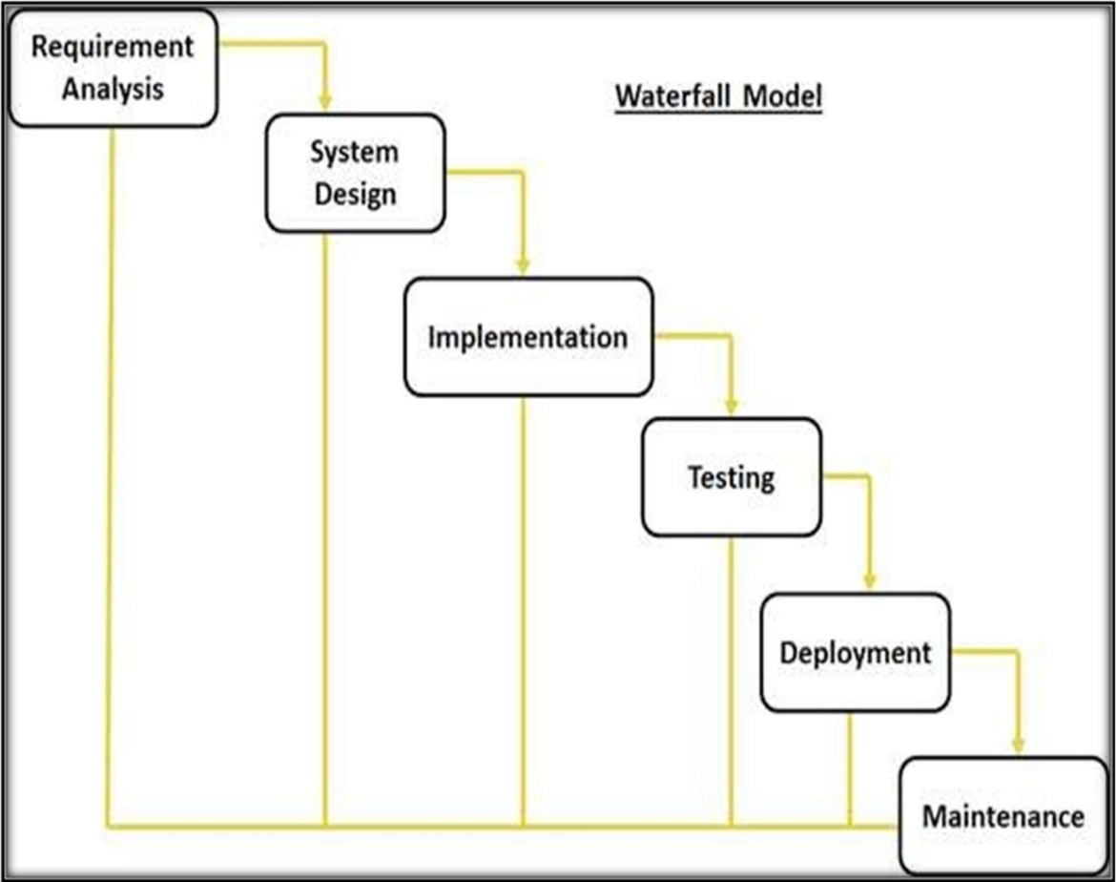
SDLC
Waterfall Model

Slide 10
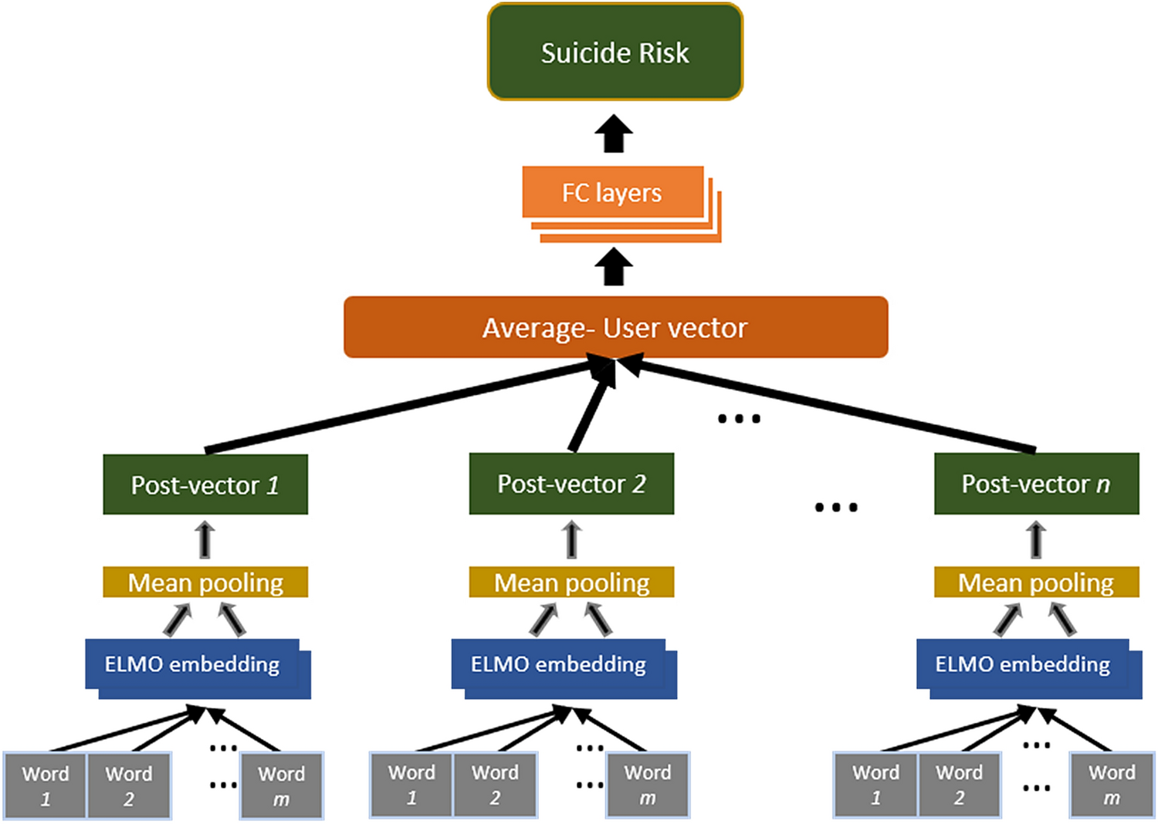
E – R Diagram

Slide 11
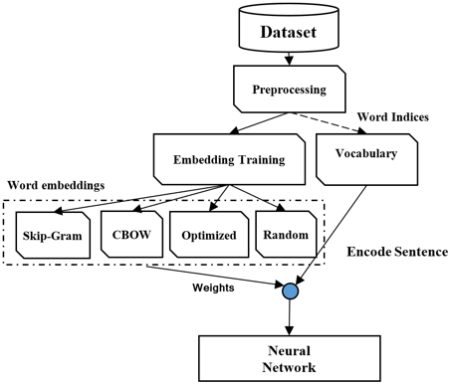
Architecture diagram

Slide 12
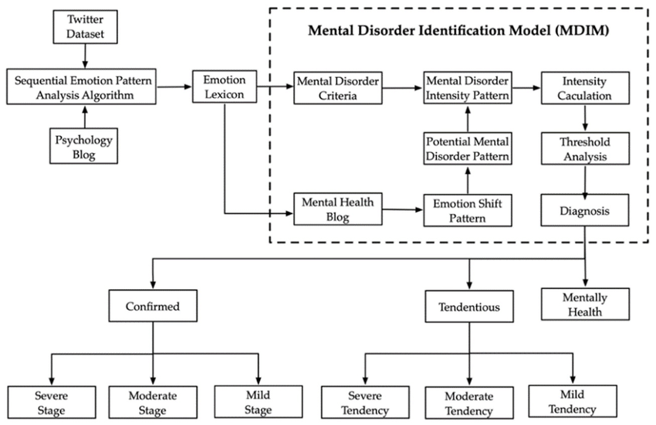
DATA FLOW DIAGRAM

Slide 16
Testing used

Slide 17
Feasibility Study:
Technical Feasibility – This section evaluates whether current technologies can support the creation of a system capable of detecting mental health disorders based on social media activity. Social media platforms have large amounts of user-generated data that can be analyzed for mental health indicators. The data may include text posts, comments, interactions (likes, shares, retweets), and multimedia content. However, obtaining this data is often restricted by privacy policies and platform terms of service.
Operational Feasibility – This section assesses whether the system can be effectively managed and operated on a practical level, considering resources, infrastructure, and workflow. The infrastructure for processing large-scale social media data requires robust computing resources, including servers, cloud storage, and powerful computational tools for machine learning and NLP tasks.
Economic Feasibility – This section assesses the financial feasibility of the project. Developing an automated system for mental health disorder detection involves substantial costs, including data acquisition, algorithm development, and system infrastructure.

Slide 18
Hardware required
CPU : multi-core processors (e.g., Intel Xeon, AMD EPYC)
GPU: High-end GPUs NVIDIA A100
RAM: 64GB
Storage : 256GB SSD

Slide 19
Software required
LANGUAGE: Python
Web Scraping Tool: Scrapy
Data Base: MySql
Text Mining Tool: Gensim, RapidMiner
Image and Video Analysis Tool: OpenCV, TensorFlow
Reporting Tool: Jupyter Notebooks

Slide 20

Future scope
Multi-platform Integration: Extend analysis to multiple social media platforms.
Multimodal Analysis: Incorporate diverse data types like images and audio.
Real-time Intervention: Implement immediate support mechanisms.
Longitudinal Analysis: Track changes in mental health states over time.
User Engagement Monitoring: Identify individuals at risk of social isolation.

Slide 21
Limitation
Data Bias: Risk of biased training data.
Privacy Concerns: Need for stringent data protection measures.
Algorithmic Accuracy: Models may produce false results.
Generalization Challenges: Performance variation across demographics.
Ethical Considerations: Stigmatization and consent concerns must be addressed.

Slide 22
THANKS
MCA
NRI INSTITUTE OF INFORMATION SCIENCE AND TECHNOLOGY ,BHOPAL
MCA

